Slide 1


MOTHER THERESA INSTITUTE OF ENGINEERING AND TECHNOLOGY
(UGC-AUTONOMOUS)
Accredited by NAAC, Approved by AICTE, New Delhi:: Affiliated to JNTUA
An ISO 9001:2015 certified Institution
(Melumoi, Chittoor district-517408, Andhra Pradesh)
DEPARTMENT OF ELECTRICAL AND ELECTRONICS ENGINEERING
TITLE OF THE PROJECT :
Design And Implementation Of Multilevel Inverters For Electric Vehicles
PRESENTED BY :
ROLL NO’S : NAMES
22HR5A0205 : N.CHAKRADHAR NAIDU
21HR1A0239 : S.RANJITH KUMAR
21HR1A0238 : S.AFROZ
21HR1A0205 : B.BHAVANA
21HR1A0234 : R.HEMANJALI
Under The Guidance Of :
Dr. S.Hareesh _{M.Tech, Ph.D}
Associate Professor

Slide 2
CONTENTS :
ABSTRACT
INTRODUCTION
WORKING MODEL
BLOCK DIAGRAM
RESULTS
APPLICATION
ADVANTAGES AND DISADVANTAGES
CONCLUSION
REFERENCES

Slide 3
ABSTRACT :
The compact and efficient design of multilevel inverters (MLIs) makes them suitable for applications such as solar photovoltaic (PV) systems and electric vehicles (EVs). This paper introduces a novel multilevel inverter topology based on a switched capacitor (SC) approach, where the number of output voltage levels is determined by the cascade connection of SC cells. The proposed design is simple, scalable to higher levels, and requires fewer active switches, resulting in reduced driver circuits, overall device count, cost, and physical size. A comprehensive review of recent trends in reduced-switch MLI topologies for EV applications is presented, along with switching patterns for better operational understanding. The paper also includes a comparative analysis of various reduced-switch MLI configurations in terms of component count, output voltage total harmonic distortion (THD), and efficiency. Additionally, the system integrates solar panels with a perturb and observe (P&O) algorithm to maintain a stable DC voltage, which is then boosted using a single input multi-output (SIMO) converter.

Slide 4
INTRODUCTION :
Growing Demand for Renewable Energy:
There is an increasing need for alternative energy sources due to fossil fuel depletion and environmental concerns.
Photovoltaic (PV) systems are among the most prominent renewable energy sources.
Role of Inverters in PV Systems:
Inverters are essential for converting DC (from PV panels) to AC for grid integration or load supply.
Performance and efficiency of the inverter significantly impact the overall effectiveness of the PV system.
Multilevel Inverters (MLI):
MLIs are gaining popularity due to advantages such as reduced harmonic distortion, lower switching losses, and operation at higher voltages with lower device ratings.
MLIs are better suited for medium- to high-power applications compared to conventional two-level inverters.
Common MLI Topologies:
The main types include Neutral Point Clamped (NPC), Flying Capacitor (FC), and Cascaded H-Bridge (CHB) inverters.
Each topology has its unique features and trade-offs in terms of complexity, cost, and control strategy.
Challenges:
Despite their advantages, MLIs have complexities such as increased component count and control difficulties.
There is ongoing research to optimize MLI design for PV systems in terms of cost, performance, and reliability.

Slide 5
WORKING MODEL
Solar PV Source (Photovoltaic)
Function: Converts sunlight into DC electricity.
Components: Consists of solar panels arranged in a specific configuration (series/parallel) to achieve desired voltage and current.
Output: Provides low DC voltage (V_PV) and current (I_PV) depending on solar irradiation and panel specifications.
Importance:
Clean and renewable energy source.
Reduces dependency on grid electricity or fossil fuels.
SIMO Boost Converter (Single Input Multiple Output)
Function: Boosts (increases) the low voltage from the solar PV to multiple higher output voltages.
Key Features:
Single input: From solar PV.
Multiple outputs: Supplies different DC voltages for different purposes (in multilevel inverter stages).
MPPT (Maximum Power Point Tracking): Ensures maximum energy extraction from solar panels by adjusting operating point.

Slide 6
Maximum Power Point Tracking (MPPT)
The MPPT controller ensures the solar PV operates at its maximum efficiency, regardless of sunlight conditions.
It dynamically adjusts the operating point to extract the maximum power output from the solar panels.
Energy Storage Capacitors
These capacitors store energy at different voltage levels.
They act as voltage sources for the inverter and smooth out any fluctuations from the boost converter.
Multilevel Inverter (MLI)
The heart of the system is a Multilevel Inverter, which synthesizes a high-quality AC output from the multiple DC inputs.
It significantly reduces Total Harmonic Distortion (THD), making it suitable for grid-tied or sensitive AC loads.
Load Connection and Output Control
The inverter output is fed to the load, which can be an AC motor, grid system, or household appliance.

Slide 7
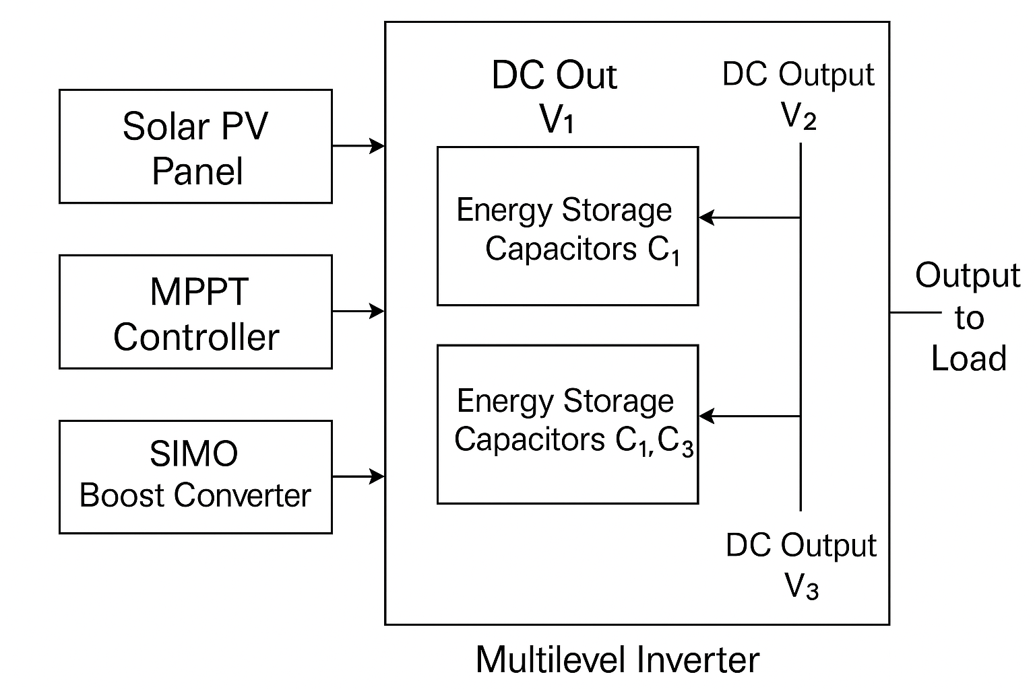
BLOCK DIAGRAM :

Slide 8
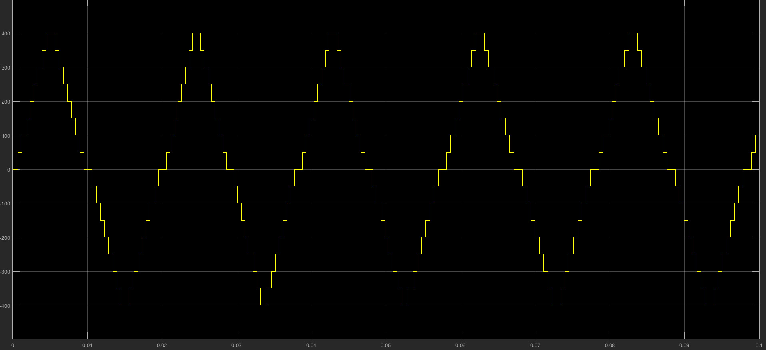
RESULTS
17 Level output Voltage waveform

Slide 9
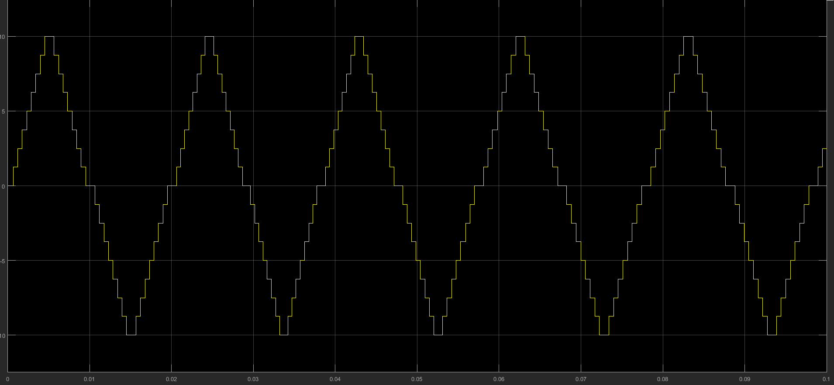
17 Level output Current waveform

Slide 10
APPLICATIONS
Electric Vehicles (EVs):
Compact and efficient design helps reduce EV weight and cost.
Suitable for on-board energy conversion systems.
Solar Photovoltaic (PV) Systems:
Works well in standalone solar systems as well as grid-connected ones.
Maintains stability under variable irradiance and temperature conditions.
Renewable Energy Systems:
Can be integrated with other renewable energy sources like fuel cells, wind energy, and hybrid power setups.
Ensures low harmonic distortion (THD < 5%), making it compliant with IEEE standards for grid integration.
High-Quality Industrial Power Supply:
Suitable for supplying pure sine-wave voltage with low harmonic content, important in sensitive industrial electronics and drives.
Smart Grids and Microgrids:
Due to its modular and scalable structure, the inverter can be adapted for distributed generation units.

Slide 11
ADVANTAGES
Increase the efficiency.
Reduce the Total Harmonic Distortion.
Reduced number of switches and gate drivers.
Smaller size, cost-effective..
Scalable to higher voltage levels without significantly increasing complexity.
Suitable for electric vehicle applications due to high efficiency.
DISAVANTAGES
For each H-bridge it required separate dc sources.

Slide 12
CONCLUSION
The proposed switched-capacitor based 17-level MLI topology for electric vehicle applications is designed and implemented for the solar PV energy system with lesser semiconductor devices to reduce the cost and size of the inverter, improving efficiency and reliability.PSO algorithm based MPPT technique is used, the stable output is achieved under all circumstances. The proposed MLI is implemented with various combinations of SC connections. A basic two units are cascaded and obtained a 17-level MLI configuration. The cascade connection of two 17-level MLIs results, and the proposed a single-phase Induction motor is place at the load of the MLI is achieved by cascading SI units. All the MLIs are designed and compared with various topologies based on several parameters like devices level count. The comparative analysis shows that the proposed MLI is more efficient with fewer power losses. The proposed MLI is tested under multiple dynamic load variations. This topology is most suited for renewable energy applications along with the EV applications.

Slide 13
REFERENCES
[1] J. Rodriguez, J.-S. Lai, and F. Z. Peng, ‘‘Multilevel inverters: A survey of topologies, controls, and applications,’’ IEEE Trans. Ind. Electron., vol. 49, no. 4, pp. 724–738, Aug. 2002.
[2] L. Franquelo, J. Rodriguez, J. Leon, S. Kouro, R. Portillo, and M. Prats, ‘‘The age of multilevel converters arrives,’’ IEEE Ind. Electron. Mag., vol. 2, no. 2, pp. 28–39, Jun. 2008.
[3] K. K. Gupta and S. Jain, ‘‘A novel multilevel inverter based on switched DC sources,’’ IEEE Trans. Ind. Electron., vol. 61, no. 7, pp. 3269–3278, Jul. 2014.
[4] L. Zhang, K. Sun, Y. Xing, and J. Zhao, ‘‘A family of five-level dualbuck full-bridge inverters for grid-tied applications,’’ IEEE Trans. Power Electron., vol. 31, no. 10, pp. 7029–7042, Oct. 2016.
[5] R. Agrawal and S. Jain, ‘‘Comparison of reduced part count multilevel inverters (RPC-MLIs) for integration to the grid,’’ Int. J. Electr. Power Energy Syst., vol. 84, pp. 214–224, Jan. 2017.
[6] K. K. Gupta, A. Ranjan, P. Bhatnagar, L. K. Sahu, and S. Jain, ‘‘Multilevel inverter topologies with reduced device count: A review,’’ IEEE Trans. Power Electron., vol. 31, no. 1, pp. 135–151, Jan. 2016.
[7] C. Dhanamjayulu, S. R. Khasim, S. Padmanaban, G. Arunkumar, J. B. Holm-Nielsen, and F. Blaabjerg, ‘‘Design and implementation of multilevel inverters for fuel cell energy conversion system,’’ IEEE Access, vol. 8, pp. 183690–183707, 2020.

Slide 14
Thank You

